Slide 1

What does being endorsed mean?

Slide 2

You have mastered
the content in your track.

Slide 3
You have Lambda School’s
stamp of approval.

Slide 4
You are ready for a job
in your field.

Slide 5

How difficult was this interview compared to your final endorsement?
53 total responses
Last updated 4/2/2020
19 (35.8%)
18 (34%)
11 (20.8%)
1: Significantly easier than Lambda’s assessment
5: Significantly more difficult than Lambda’s assessment
5 (9.4%)
0 (0%)
1
2
3
4
5
Notes:
On our survey that our Solutions team sent to students who had recently been in an interview, the following question was asked
These are the most up to date results from that survey, and it shows that students were pretty prepared for their interviews after going through the Endorsement Unit and being fully endorsed

Slide 6
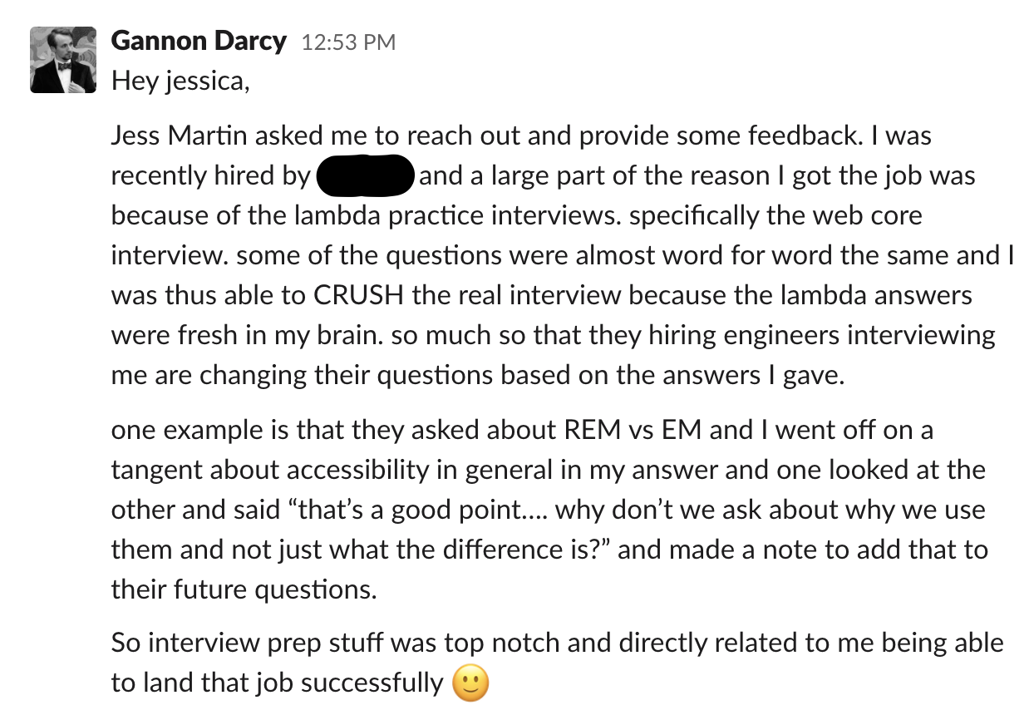
Notes:
On our survey that our Solutions team sent to students who had recently been in an interview, the following question was asked
These are the most up to date results from that survey, and it shows that students were pretty prepared for their interviews after going through the Endorsement Unit and being fully endorsed

Slide 7

You unlock the following resources:
1
Access to the Match Program through the Solutions Team, who are support your job search through setting you up with interviews, talking to hiring managers, and training you on how to get your own job
2
Be featured on the Showcase landing page with your own public-facing profile. A page that both Hiring Partners and the general public have access to.
3
Continued access to expert Lambda Staff in the Lambda X program.
4
Unlimited Careers-related help and services.
5
Unlimited technical interview support.
Notes:
By being endorsed you unlock the following resources offered at Lambda

Slide 8
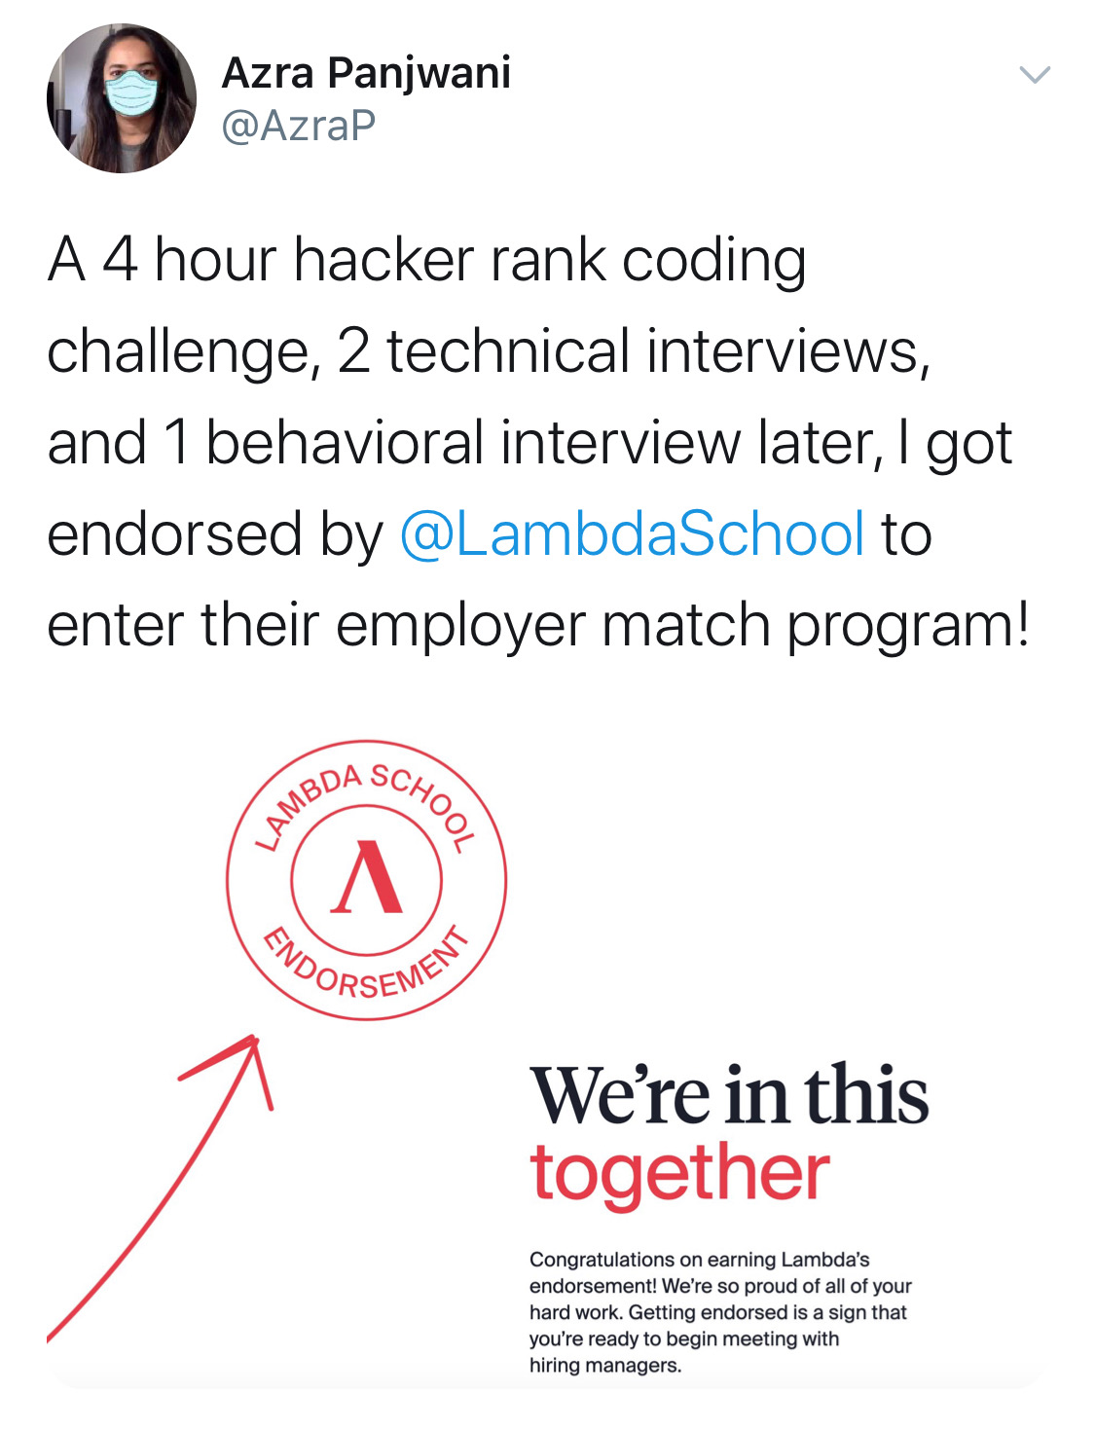
Way to go Azra!
Notes:
Azra just got endorsed and is now eligible to participate in the Match Program! Way to go :)

Slide 9

How do I get endorsed?
Notes:
JI
So you wondering what you need to do in order to tweet like Azra?
We’ll go over how you get endorsed!

Slide 10

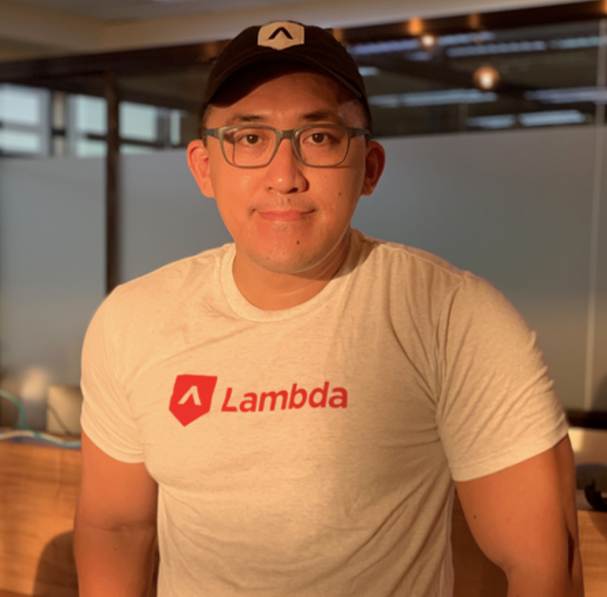
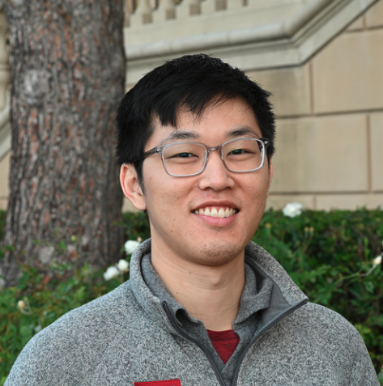
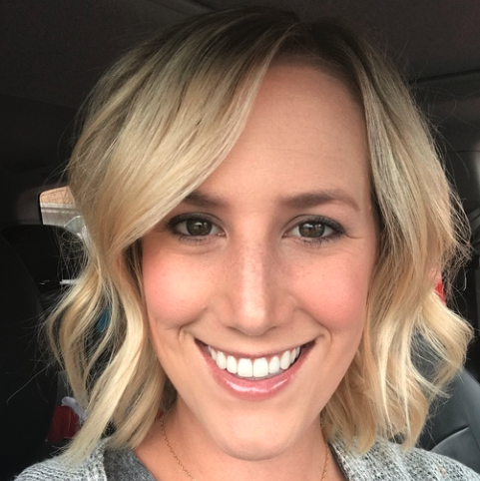
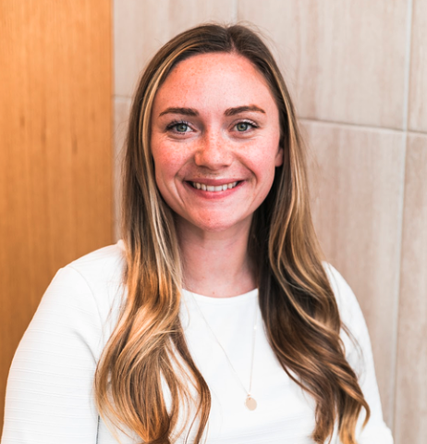

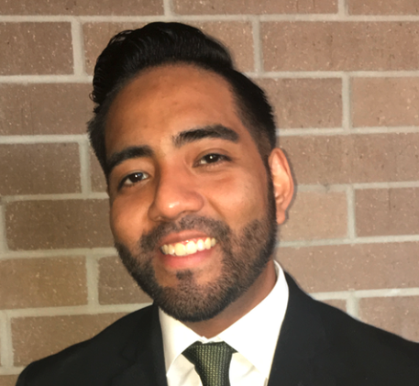
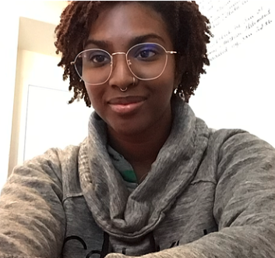
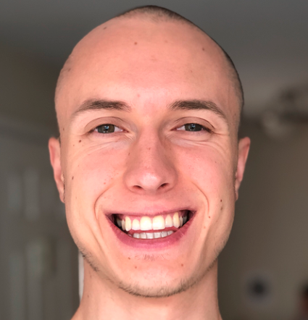

Get to know your Endorsement Staff
Jess Wilkinson
Endorsement Program Manager
Katie Spencer
Careers
Dante Cuales, Jr.
Student Success Coordinator
Sean Chen
Instructor of Technical Mastery
Jordan Isbell
Careers
Robert Valderrama
Student Leadership Coordinator
Kayanna Chandler
Endorsement Unit SL
Dylan Dislers
Endorsement Unit SL
A. Lowell Richardson
Endorsement Unit SL
Notes:
First, get to know the staff who will supporting you through this Unit
You’ll hear from each of these staff members throughout your team, and feel free to reach out to them as well as your TL for guidance!

Slide 11
Participate in the Endorsement Unit.
You’ll get endorsed by submitting the required artifacts, passing your core track interviews, and taking your assessments. The schedule is built for you to complete all of this in 1 unit’s time (4 weeks).
Notes:
Let’s break down everything you’ll need to do and complete in order to be endorsed.

Slide 12
1
Technical Assessment.
For Web, Android and iOS
Pass a final track specific interview with a technical interviewer
Pass the HackerRank code challenge and associated interview
For DS
Pass a final track specific interview with a technical interviewer
For UX
Pass off your resume and portfolio with a Design Manager.
Notes:
First you will be taking technical assessments to gauge your mastery of the content. You will have multiple tries, so don’t be afraid to hop into this! Let’s gauge where your current understanding is, so we know how to best support you going forward.
This first week of the Endorsement Unit, you will schedule your technical assessment. Information on how to do that will be in the Endorsement Handbook you are given.

Slide 13

DS Interview
Topics
Data Storytelling
Model Comparison
Software Engineering
Natural Language Processing
Deep Learning
You will schedule an hour long Data Science interview which will contain technical and conceptual questions. Link to mock job description here.
What you will do
- Explore and understand rich and varied datasets
- Develop insight, and share it with others
- Build real systems!
What you will need
- Python
- Statistics
- Basics of Deep Learning

Slide 14
Web Interview
Topics
Javascript
Advanced CSS
Single Page Apps
APIs
SQL
Redux
Node.JS (or Java)
You will schedule an hour long Web Interview
What you will do
- Demonstrate your mastery of Front End and Back End Web Development.
- Answer questions through your previous projects
- You will not be scored on your code but it will be a starting point for discussion.
What you will need
- Links to Build Week 3 and 4 projects
- Link to Labs project
- Link to any other personal projects (optional)

Slide 15
iOS Interview
Topics
iOS Fundamentals
Networking and Persistence
Core Data
Architecture and Persistence
Objective-C and Beyond
You will schedule an hour long iOS interview.
What you will do
- Show your mastery of concepts from each of the iOS Development Sprints
-Provide examples of your answers in your code
What you will need
- Links to iOS app projects.

Slide 16
Android Interview
Topics
Android Fundamentals
User Interface
Kotlin
Data Persistence
Code Quality
Java and Spring
RDBMS and APIs
You will schedule an hour long Android Interview
What you will do
- Show your mastery of concepts from each of the Android Development Sprints
-Provide examples of your answers in your code
What you will need
- Links to Android app projects.

Slide 17
Sprint Challenge: HackerRank
Code Challenge
The code challenge will be administered using HackerRank. You will be asked to solve three or four coding problems (depending on the version of the assessment). We recommend the language of your core program, but you can choose between JavaScript, Python, Java, or Swift.
Each version of the HackerRank assessment has a time limit equal to one hour per problem. For example, if the version of the HackerRank you receive has four problems then you will have four hours to complete the assessment. You do not have to break up the time evenly between problems. You may, for example, choose to spend two hours on one problem and 30 minutes on each of the remaining three.
HackerRank runs your code for each problem against a large number of test cases (additional to the test cases shown to you during the assessment). Your score is the total percentage of test cases passed. Your score is not affected by the time it takes you to complete each problem.
Possible Results
A passing score is considered 60% or higher.

Slide 18
Code Challenge Interview
Topics
Code Readability
Problem solving strategy
Time and space complexity
You will schedule an 30 minute long code challenge
What you will do
- Discuss your answers on the code challenge assessment.

Slide 19
2
Behavioral Interview
Complete a behavioral interview with a coach (30 minutes). You’ll be primarily working with Jordan Isbell and Katie Spencer in order to prepare for this requirement.
Notes:
You will practice these on Wednesdays with your TL. You can also practice on Pramp.com, or with each other.

Slide 20
3
Career Artifacts.
Pass off the following artifacts with a Career Coach:
Polished LinkedIn profile (All)
Polished resume (Web, DS, And, & iOS)
Active blog or portfolio site (Web & DS)
Active app in app store (And & iOS)
Active GitHub (Web, DS, And, & iOS)
Notes:
You will be submitting these items first to your TL for feedback, so you can continue to iterate and improve your artifacts. Once approved by your TL they will move on to coaches for approval. Does not need to be perfect from the get-go, but you need to commit to implementing the feedback in order to get to that final polished artifact.

Slide 21
What’s it like to be in the Endorsement Unit?
Notes:
KT

Slide 22


Sprint Challenges
Sprint #1
Sprint #2
Sprint #3
Sprint #4
Web, And & iOS: HackerRank code challenge
UX & DS: Artifacts
By Friday, everyone should have a scheduled core track interview and behavioral interview
Web, And & iOS: HackerRank code challenge reattempt
All: Submit links to artifacts in sprint retro
Resume
LinkedIn
Blog/Portfolio/App
GitHub
HackerRank code challenge reattempt
Re-submit artifacts, if needed
Interview reattempt scheduled, if needed
HackerRank code challenge reattempt
Re-submit artifacts, if needed
You’re
Endorsed!*
*Note: You can get endorsed and be onboarded into the Match program after any sprint.
You don’t have to wait until sprint 4.

Slide 23
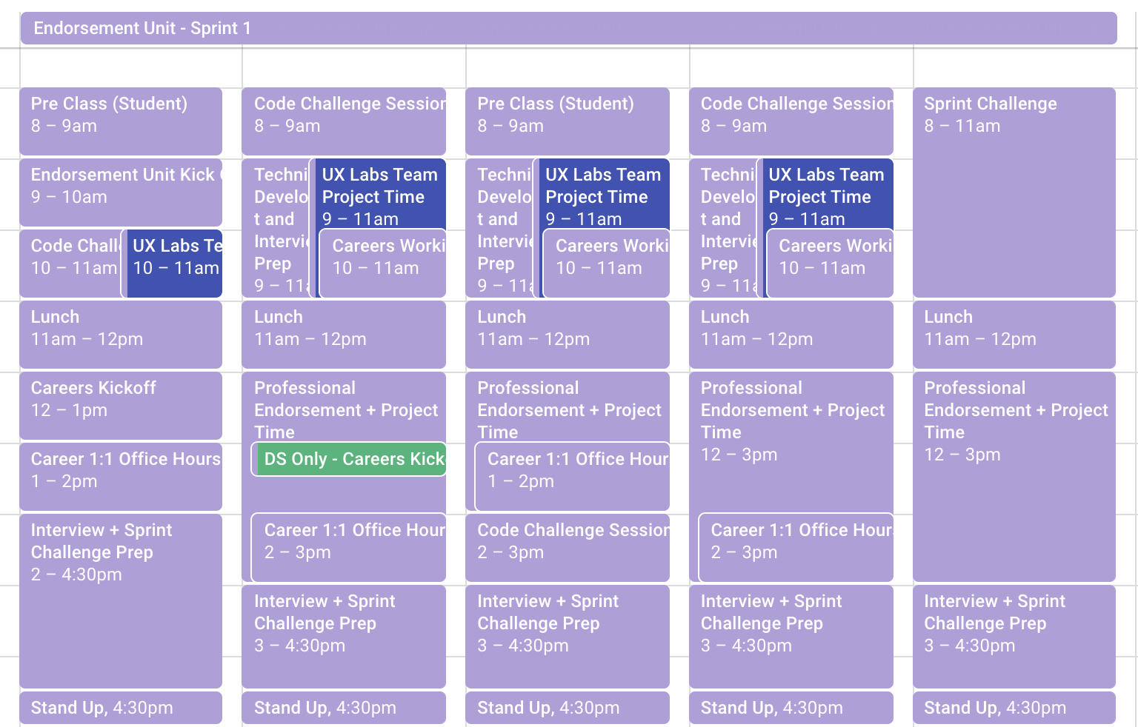
Weekly Schedule - Sprint 1
Notes:
Here is an overview of what your calendar looks like in the Endorsement Unit
You’ve got Code Challenges, Technical Development, Careers lessons, Core Track interview prep, and project time
Everything you need to get endorsed within 1 Unit’s time (4 weeks)

Slide 24
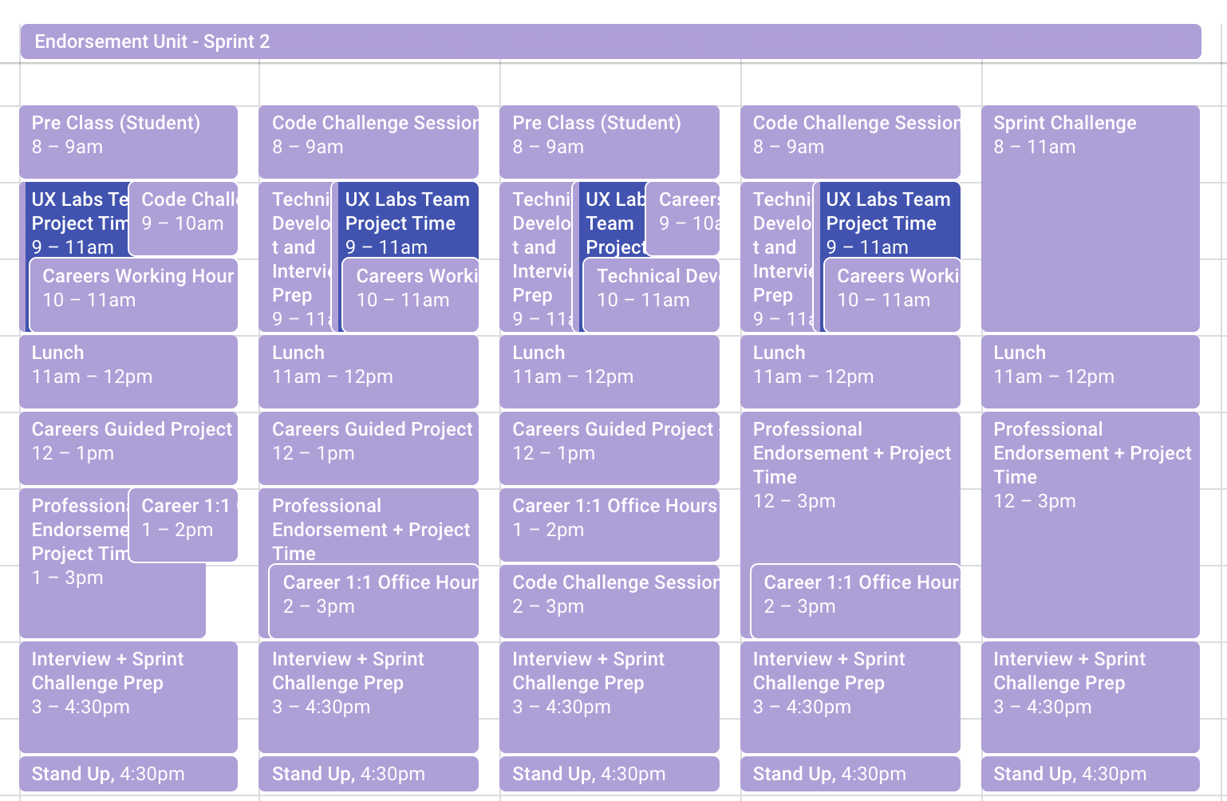
Weekly Schedule - Sprint 2
Notes:
Here is an overview of what your calendar looks like in the Endorsement Unit
You’ve got Code Challenges, Technical Development, Careers lessons, Core Track interview prep, and project time
Everything you need to get endorsed within 1 Unit’s time (4 weeks)

Slide 25
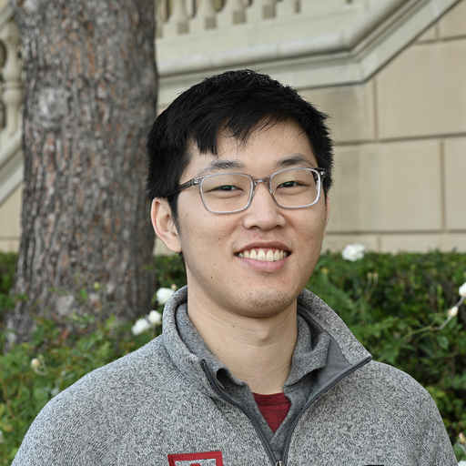



Hi Web, iOS, And, & DS students!
I lead the Endorsement Unit lectures that are aimed at teaching code challenge and whiteboarding best practices. If you have questions related to these topics, my DMs are always open!
Sean Chen
Instructor of Technical Mastery
Notes:
This guy is gonna be your best friend when it comes to whiteboarding practice

Slide 26
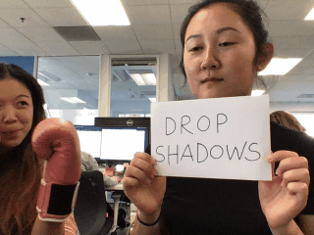

Hi UX students!
If you’re continuing your Labs project, please only work on it in the mornings. Communicate this change with your team and set boundaries
Instead of weekly design critiques, Elizabeth and Lisa host portfolio roasts every Thursday at 2pm
Every Wednesday at 1pm, we do lightning talks!
Portfolio questions? Reach out to Elizabeth Lin
Resume feedback? Reach out to Lisa Inoue
Share your work with Elizabeth and Lisa early and often!
Your TL will host practice whiteboard challenges with you once a week
Your SL is Imani! Reach out to her with any questions.
Notes:
EL

Slide 27
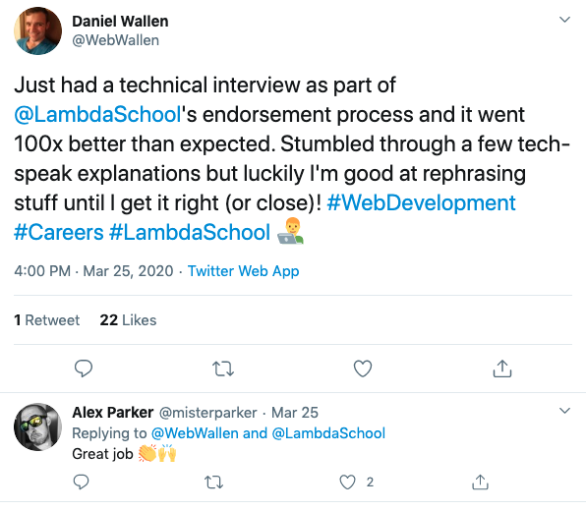
Technical Interview Prep.
You have multiple tries (4 to be exact) at passing your Endorsement Technical Assessment. That’s so you can improve while in our safety net, then crush it when you’re at job interviews!
Notes:
Don’t be scared to take your Endorsement Technical Assessment, they are practice runs before you go out on the job search!
It’s so we can help you fill gaps in your knowledge before you hit the real interview

Slide 28
Expectations & Policies
No Cheating
No cheating on your technical assessments. If it is discovered that you cheated, you will be put on a 3-month probation.
Interview No-Shows
If you do not show up for a scheduled interview, you will be placed on a Success Plan.
HackerRank tests
If you haven’t been able to pass after three attempts, schedule a meeting with Sean Chen. We’ll make sure you’ll get the help you need!
Professional Endorsement Guided Projects
If your materials aren’t checked off, you are required to attend the Guided Lectures
Office Hours
Utilize the open office hours, it’ll help you complete your Career Artifacts quicker.
*More details included in the Endorsement Student Handbook
Notes:
JI
Some of you have already completed your endorsement for materials and/or behavioral interviews. If your materials are not checked off yet, you gotta come to Guided Lectures Week 1. Materials can move really quickly after face-time with a member of the Careers team, so use us!
If you do not submit any materials after Sprint 1, remember they don’t have to be perfect, but we do need that touch point! We will have to move forward with getting you on a success plan and regular check-ins with one of us.

Slide 29
Endorsement Handbook.
You can find all the information you need on your Endorsement Student Handbook:
https://www.notion.so/lambdaschool/Endorsement-Student-Handbook-515d50d85a51455eaa6b1dcaafaaf97d

Slide 30
What happens after I get endorsed?

Slide 31

You’ll join Lambda X!
I manage the Lambda X program where you’ll be applying for jobs, sharpening your coding/design skills on project teams, and getting loads of interview prep.
We host brownbags from senior leaders in the tech industry, get you connected with the Match Program, work on your Showcase video/profile content, and host job search parties. You can also sign up for our AWS Cloud Practitioner Certification!
Being endorsed gives you a leg up on the interview and job search process. Excited to see you in the next unit!
Alice Karsevar
Lambda X Program Manager

Slide 32

Our level of excitement when you get endorsed.
Notes:
We are all here to support you, and get a sugar high off your success like this girl does off of cotton candy

Slide 33







Questions?

